Slide 1

Department of Computer Science
University Institute of Engineering
DEPARTMENT OF COMPUTER SCIENCE & ENGINEERING
Bachelor of Engineering
Subject Name: System Programming
Subject Code: CST-315
Compilers
DISCOVER . LEARN . EMPOWER

Slide 2
Chapter 7
Loading Schemes

Slide 3
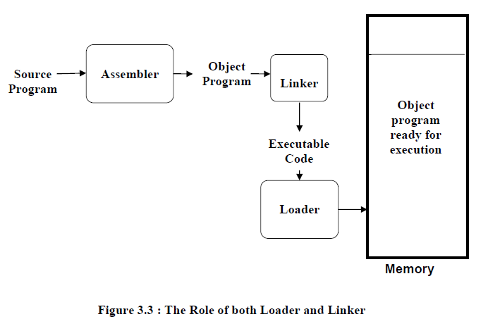

Slide 4
Loading Scheme
Program modules A and B are loaded in memory after linking. It is ready for execution
Object Module
A
A
Loader
B
Object Module
B
Fig.: General Loading scheme
Notes:
Program modules A and B are loaded in memory after linking. It is ready for execution

Slide 5
Functions of Loader
The loader is responsible for the activities such as allocation, linking, relocation and loading
Allocation: allocating the space for program in the memory, by calculating the size of the program.
Linking: It resolves the symbolic references (code/data) between the object
Relocation: Address dependent locations in the program, such address constants must be adjusted according to allocated space
Loading: Physically places all the machine instructions and data into the memory

Slide 6
Loading Schemes…
Various types of loader ,based on various functionalities
Compile and go loader / Assemble and go loader
General loader scheme
Absolute loader
subroutine linkage
Relocating loader
Direct linking loader

Slide 7
1.Compile and Go Loader /Assemble and go loader
Also Called Assemble and go loader
In this type of loader, the instruction is read line by line, its machine code is obtained and it is directly put in the main memory at some known address.
That means the assembler runs in one part of memory and the assembled machine instructions and data is directly put into their assigned memory locations.
After completion of assembly process, assign starting address of the program to the location counter.
Ex: WATFOR-77

Slide 8
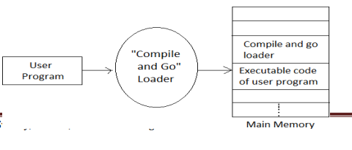
Compile and go loader or Assemble and go loader

Slide 9
1.Compile and go loader….
Advantages:
It is very simple to understand.
It is simple to implement because loader is just an extension to the assembler design.

Slide 10
Disadvantages:
1.Compile and go loader….
Portion of the memory is wasted because the assembler resides in the memory.
It is necessary to assemble every time even though no modifications are being done.
Can not handle multiple program segments especially if they are written in different languages (e.g. assembly lang. and FORTRAN or PL/I)
Scheme is good for small program not for bigger one
Execution time = assemble time + load time

Slide 11
2.General loader scheme
In this loader scheme, the source program is converted to object program by some translator (assembler).
The loader accepts these object modules and puts machine instruction and data in an executable form at their assigned memory.
The loader occupies some portion of main memory.

Slide 12
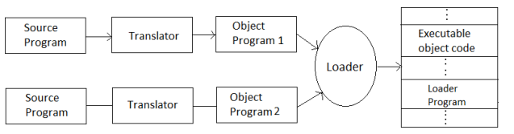
General Loader Scheme

Slide 13
2.General loader scheme
Advantages:
• The program need not be retranslated each time while running it
• There is no wastage of memory, because assembler is not placed in the memory
• It is possible to write source program with multiple programs and multiple languages

Slide 14
3.Absolute Loader
An Absolute loader is the simplest of all other loaders.
It takes the output of Assembler and load into memory without relocation.
Absolute loader is a kind of loader in which relocated object files are created, loader accepts these files and places them at specified locations in the memory.
This type of loader is called absolute because no relocation information is needed; rather it is obtained from the programmer or assembler.
Notes:
Object desk: containing coded form of the instruction is called object desk

Slide 15
3.Absolute Loader
The starting address of every module is known to the programmer, this corresponding starting address is stored in the object file, then task of loader becomes very simple and that is to simply place the executable form of the machine instructions at the locations mentioned in the object file.
In this scheme the programmer or assembler should have knowledge of memory management.
The resolution of external references or linking of different subroutines are the issues which need to be handled by the programmer.
Notes:
Object desk: containing coded form of the instruction is called object desk

Slide 16
3.Absolute Loader….
Binary program is stored in a file that contains:
Header records: Contains load Origin ,Length of code, load time execution starting address of program.
Transfer record: contains entry point of execution
Notes:
Object desk: containing coded form of the instruction is called object desk

Slide 17
3.Absolute Loader
The programmer should take care of two things:
first thing is: i. Specification of starting address of each module to be used. If some modification is done in some module then the length of that module may vary. This causes a change in the starting address of immediate next modules, its then the programmer's duty to make necessary changes in the starting addresses of respective modules.
Notes:
Object desk: containing coded form of the instruction is called object desk

Slide 18
Problem in Absolute loader….
For Example:
Main() and SQRT( ) is loaded at memory location 150-300 bytes an 450-500bytes respectively.
If Main() will be modified it might be increase its size of code(may be more than 200 bytes) at that point Main() overlaps the content of SQRT().
Since its MAIN() code size become 150+350=500 Which crosses the load origin of subroutine SQRT() which violets the scheme of absolute loader.
So,It is necessary to assign SQRT() to new location in the memory.
For that its Start address have to be changed and re-assembling is required.
Also be necessarily to modify all other subroutines that referred to the address of SQRT();

Slide 19
3.Absolute Loader
The programmer should take care of two things:
ii. Second thing is, while branching from one segment to another the absolute starting address of respective module is to be known by the programmer so that such address can be specified at respective JMP instruction. For example
Notes:
Object desk: containing coded form of the instruction is called object desk

Slide 20
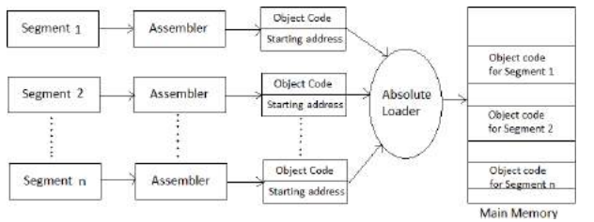
Absolute Loader

Slide 21
3.Absolute Loader
Thus the absolute loader is simple to implement in this scheme
Allocation is done by either programmer or assembler
Linking is done by the programmer or assembler
Resolution is done by assembler
Simply loading is done by the loader
Notes:
Object desk: containing coded form of the instruction is called object desk

Slide 22
Absolute loader.
Disadvantages:
Programmer must specify the starting address to the assembler for the program where it should be loaded.
so programmer must know memory management as well as memory status at any time.
It is very difficult to relocate in case of multiple subroutine.

Slide 23
Design of an Absolute Loader
Algorithm:
Begin
Read Header record
Verify program name and length
Read first text record
While record type <> ‘E’ do
Begin
{
If object code is in character form, convert into internal presentation
}
Move object code to specified location in memory.
Read next object program record.
End
Jump to address specified in end record
end

Slide 24
4. Subroutine Linkages/Program Linking Loader
Subroutine: In given program ,it is often needed to perform a particular subtask many times on different data values. such a subtask is usually called a subroutine.
Subroutine linkage method: The way in which a machine makes it possible to call and return from subroutine is referred to as its Subroutine linkage method

Slide 25
4. Subroutine Linkages/Program Linking Loader
To understand the concept of subroutine linkages, first consider the following scenario:
"In Program A a call to subroutine B is made.
The subroutine B is not written in the program segment of A, rather B is defined in some another program segment C"
Nothing is wrong in it.
But from assembler's point of view while generating the code for B, as B is not defined in the segment A, the assembler cannot find the value of this symbolic reference and hence it will declare it as an error.
To overcome problem, there should be some mechanism by which the assembler should be explicitly informed that segment B is really defined in some other segment C.

Slide 26
4. Subroutine Linkages/Program Linking Loader
Therefore whenever segment B is used in segment A and if at all B is defined in C, then B must - be declared as an external routine in A.
To declare such subroutine as external, we can use the assembler directive EXT.
Thus the statement such as EXT B should be added at the beginning of the segment A.
This actually helps to inform assembler that B is defined somewhere else.
This overall process of establishing the relations between the subroutines can be conceptually called a subroutine linkage.

Slide 27
5. Relocating Loaders
Loader that allow for program relocation are called relocating loader/relative loader.
The relocating loader will load the program anywhere in memory, altering the various addresses as required to ensure correct referencing.
To avoid possible reassembling of all subroutines when a single subroutine is changed and to perform the tasks of allocation and linking for the programmer the relocating loader is created.

Slide 28
Relocating Loaders….
Example: BINARY SYMBOLIC SUBROUTINE(BSS)loader used in the IBM 7094,IBM 1130,GE 635.
The output of a relocating assembler using a BSS scheme is the object program & information about all program it reference.

Slide 29
Relocating Loaders…
Transfer Vector: that consists of address containing names of the subroutines referenced by the source program.
After loading the text and the transfer vector into core, the loader would load each subroutine identified in the transfer vector.

Slide 30
Relocating Loaders :Example
MAIN START
EXTERNAL SORT
EXTERNAL ERR4
LOAD 1,=F9
BALINK 14,SQRT
COMPARE 1,=F3
BNE ERR
HLT
=9 DATA 9
=3 DATA 3
END
LC r / s / e
0 00 SORT
4 00 ERR
8 01 LOAD 1,1C
C 01 BALINK 14, 0
10 01 COMPARE 1,20
14 01 BNE 4
18 00 HLT
1C 00 0009
20 00 0003

Slide 31
Relocating Loaders :Advantages
Relocation bits are used to solve the problem of relocation.
Transfer vector is used to solve the problem of linking & Program length info to solve allocation.

Slide 32
Relocating Loaders :DisAdvantages
No suited for loading external data.
Transfer vector increase the size.
Does not facilitate access to data segment that can be shared.

Slide 33
6. Direct linking loader:
It is type of Re-locatable Loader.
It is most common type of loader.
It allows the programmer to use multiple procedure segments and multiple data segments.
The loader cannot have the direct access to the source code.

Slide 34
Direct Linking Loader…
The assembler should give the following information to the loader:
1.The length of the object code segment.
2.A list of all symbols which are not defined in the current segment but can be used in the current segment.
3.A list of all symbols which are defined in the current segment but can be referred in the current segment.
4.Information about address constants.
5.Machine code translation of the source program and relative address.
To place the object code in the memory there are two situations:
1. Address of the object code could be absolute.
2. The address of object code can be relative.

Slide 35
Direct linking loader:
The list of symbols not defined in the current segment but used in the current segment are stored in a data structure called USE table.
The lists of symbols defined in the current segment and referred by the other segments are stored in a data structure called DEFINITION table.

Slide 36
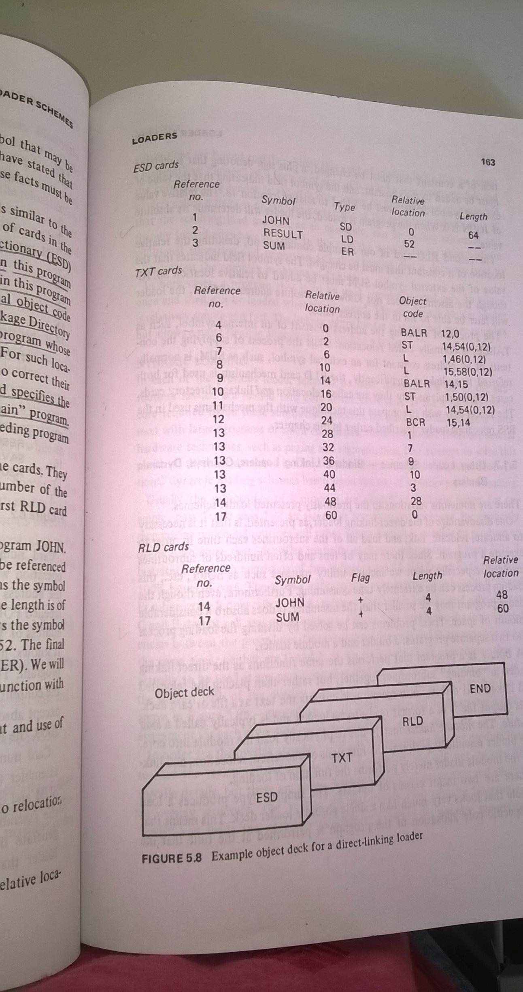
Assembler records
Assembler generates 4 types of cards in the object desk:
ESD:External Symbol Dictionary (ESD) record:
TXT: (TXT) records.
RLD: Relocation and Linkage Directory (RLD):
END :End of object deck

Slide 37
Assembler records…ESD
1.ESD:External Symbol Dictionary (ESD) record:
Card contain information about all symbol that are defined in this program, but that may reference elsewhere, and all symbol referenced in this program but defined elsewhere.

Slide 38
Assembler records…ESD
1.ESD:External Symbol Dictionary (ESD) record:
Card contain information about all symbol that are defined in this program, but that may reference elsewhere, and all symbol referenced in this program but defined elsewhere.
Type:
SD: segment definition: symbol in segment
LD: Local definition: symbol is defined in this program but it can be referenced by other program.
ER: External symbol: defined in some external program.
Source object record no./card no. | symbol | Type | Relative Location | Length
1 | MAIN | SD | 0 | 36
2 | RESULT | LD | 32 | -
3 | SUM | ER | - | -

Slide 39
Assembler records…TXT
2. TXT: (TEXT) records.
Text card contains actual object code.(translated source code).

Slide 40
Assembler records…RLD
3. RLD: Relocation and Linkage Directory (RLD):
This card contains information about location in the program whose contexts depends on the address at which the program is placed.
In this we are used ‘+’ and ‘–‘sign,
when we are using the ‘+’ sign then no need of relocation,
when we are using ‘-‘sign relocation is necessary.
The format of RLD contains:
Reference number
ii. Symbol
iii. Flag
iv. Length
v. Relative location
Notes:
+ sign denote that something must be added to the constant

Slide 41
Assembler records…END
4.END: card indicate the end of object deck.
Notes:
+ sign denote that something must be added to the constant

Slide 42
advantages of Direct Linking
Allow multiple procedure and data segment.
Allow independent translation of the program.
Relocation Faclility

Slide 43
Disadvantages of Direct Linking
Not suitable in multitasking.
It is necessary to allocate, relocate, link, and load all of the subroutines each time in order to execute a program
loading process can be extremely time consuming.

Slide 44
Design of Direct Linking Loader
Design of direct linking loader is more complicated than absolute loader.
Input to loader is object module and this is divide into 4 section ESD,TXT,RLD,END
It requires two passes to complete the linking process
Pass I: assigns addresses to all external symbols (Uses Global EST: GEST)
Pass II: performs actual loading, relocation and linking.

Slide 45
Design of Direct linking loader…
In Pass I ,a Global External Symbol table(GEST) is prepared.
It contain every external symbol and corresponding absolute address value.

Slide 46
Fig. Two pass direct linking loader scheme
Copy of object records
Object Module
Main Memory
Pass I
Pass II
GEST
Object Module

Slide 47
Example
Write entries of ESD,TXT,RLD,& Global External Symbol Table(GEST) for PG1,PG2 given below

Slide 48
Object Record no. | Relative Address | Source Program
1. | 0 | PG1 | START
2. |  |  | ENTRY PG1EN1,PG1EN2
3. |  |  | EXTRN PG2EN1, PG2
4. | 20 | PG1EN1 | =
5. | 30 | PG1EN2 | =
6. | 40 |  | DC A (PG1EN1)
7. | 44 |  | DC A (PG1EN2+15)
8. | 48 |  | DC A (PG1EN2-PG1EN1-3)
9. | 52 |  | DC A (PG2)
10. | 56 |  | DC A (PG2EN1+PG1EN1+4)
11. | 60 |  | END

Slide 49
Object Record no. | Relative Address | Source Program
12. | 0 | PG2 | START
13. |  |  | ENTRY PG2EN2
14. |  |  | EXTRN PG1EN1, PG1EN2
15. | 16 | PG2EN1 | =
16. | 24 |  | DC A (PG1EN1)
17. | 28 |  | DC A (PG1EN2+15)
18. | 32 |  | DC A (PG1EN2-PG1EN1-3)
19. | 36 |  | END

Slide 50
Object Records For Module PG1:1.ESD record
Source object record no. | Name | Type | ID | Relative Address | length
1. | PG1 | SD | 01 | 0 | 60
2. | PG1EN1 | LD | - | 20
3. | PG1EN2 | LD | - | 30
4. | PG2 | ER | 02 | -
5. | PG2EN1 | ER | 03 | -

Slide 51
Explanation
SD: Segment definition
LD: Local definition (declared in this seg, can be used by others)
ER: External definition (declared in other , can be used by this)
Each SD and ER symbol is given unique numeber which is to used in RLD

Slide 52
TEXT records
Source object record no. | Relative Address | Contents | Comments
6 | 40-43 | 20 | ADDr PG1EN1=20
7 | 44-47 | 45 | Addr PG1EN2+15=45
8 | 48-51 | 7 | Addr PG1EN2-PG1EN1-3= 7
9 | 52-55 | 0 | Addr PG2 is not known
10 | 56-59 | -16 | Addr of PG2EN1 +PG2-PG1EN1+4 =0+0-20+4 = -16

Slide 53
Object Records For Module PG1: 3.RLD record
Source object record no. | ESD_ID | Length(in Byte) | Flag + or - | Relative Address
6 | 01 | 4 | + | 40
7 | 01 | 4 | + | 44
9 | 02 | 4 | + | 52
10 | 03 | 4 | + | 56
10 | 02 | 4 | + | 56
10 | 01 | 4 | - | 56
Notes:
Difference between two relative address constant.therefore the entry 8 48 DC A(PG1ENT2-PG1ENT1-3)will not appear in RLD record

Slide 54
Object Records For Module PG2:1.ESD record
Source object record no. | Name | Type | ID | Relative Address | length
12. | PG2 | SD | 01 | 0 | 36
13. | PG2ENT1 | LD | - | 16 | -
14 | PG1EN1 | ER | 02 | - | -
14 | PG1ENT2 | ER | 03 | - | -

Slide 55
TEXT records
Source object record no. | Relative Address | Contents
16 | 24-27 | 0
17 | 28-31 | 15
18 | 32-35 | -3

Slide 56
Object Records For Module PG1: 3.RLD record
Source object record no. | ESD_ID | Length(in Byte) | Flag + or - | Relative Address
16 | 02 | 4 | + | 24
17 | 03 | 4 | + | 28
18 | 03 | 4 | + | 32
18 | 02 | 4 | - | 32
Notes:
Difference between two relative address constant. therefore the entry 8 48 DC A(PG1ENT2-PG1ENT1-3)will not appear in RLD record

Slide 57
GEST
Contain external symbol and its corresponding address.
If we assume that PG2 is loaded at location 268.
External Symbol | Assigned Memory Address
PG1 | 208
PG1ENT1 | 228
PG1ENT2 | 238
PG2 | 268
PG2ENT1 | 284

Slide 58
LESA:Local External Symbol Array
LESA is created for each segment.it contains SD & LD type entries of each segment.
LESA for PG1
LESA for PG2
 | Assigned Memory Address
PG1 | 208
PG1ENT1 | 228
PG1ENT2 | 238
 | Assigned Memory Address
PG2 | 268
PG2ENT1 | 284

Slide 59
Assignment Question
Write entries of ESD,TXT,RLD,& Global External Symbol Table(GEST) for MAIN,PRO given below
Assume initial program load address as 400.

Slide 60
Object Record no. | Relative Address | Source Program
1. | 0 | MAIN | START
2. |  |  | ENTRY M1,M2
3. |  |  | EXTRN PROG, P1,P2
4. | 20 | M1 | =
5. | 30 | M2 | =
6. | 50 |  | DC A (M2)
7. | 54 |  | DC A (M1+5)
8. | 58 |  | DC A (M2-M1-4)
9. | 62 |  | DC A (PROG)
10. | 66 |  | DC A (P1+P2-PROG)
11. |  |  | END

Slide 61
Object Record no. | Relative Address | Source Program
12. | 0 | PROG | START
13. |  |  | ENTRY P1,P2
14. |  |  | EXTRN M1,M2
15. | 16 | P1 | =
16. | 26 | P2 | =
17. | 36 |  | DC A (M1)
18. | 40 |  | DC A (M2+10)
19. |  |  | DC A (P2-P1-3)
20. |  |  | END

Slide 62
Loader Design Options
Linking loaders – all linking and relocation at load time
Linkage editors – perform linking prior to load time
Dynamic linking – performed at execution time

Slide 63
Overlay Structure
Program execution need not be achieved by loading all the parts of large program in memory.
So,that we can reduce memory requirement of such program by loading required parts of program in memory.
Hence some parts of program are given the same load address during linking.
Therefore,at any time,only one of these parts of program can be loaded in memory because loading of other parts that has same load address will overwrite it.

Slide 64
Overlay Structure…
Overlay is a part of program that has same load origin as some other parts of the program .and the program which contains overlays is called as overlay structured program.
It consist of Permanently resident portion known as ROOT.
Set of overlays that will e loaded in memory as per the requirements.
Overlay manager is linked with the root.
Root is loaded in memory .

Slide 65
Example
Suppose a program consisting of five subprograms (A{20k},B{20k}, C{30k}, D{10k}, and E{20k}) that require 100K bytes of core.
Subprogram A only calls B, D and E;
subprogram B only calls C and E;
subprogram D only calls E
subprogram C and E do not call any other routines
Note that procedures B and D are never in used the same time; neither are C and E.

Slide 66
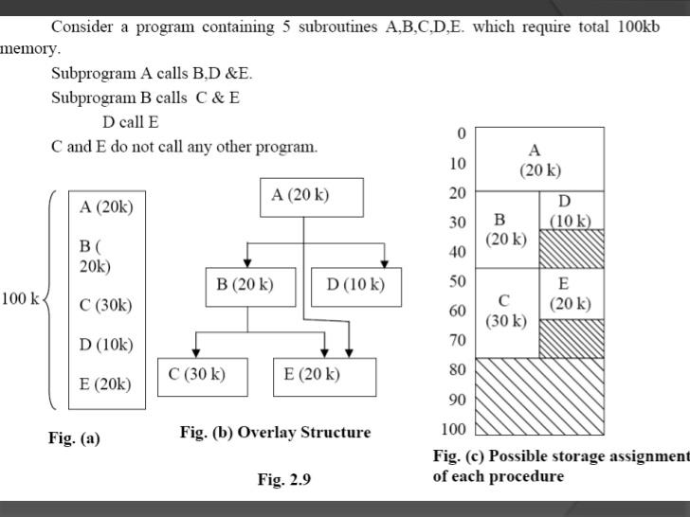

Slide 67
Self- Relocatable Programs
Classification of program based on how that program may be relocated to execute from a specified area of memory as follows:
Non-relocatable program
Relocatable program
Self-relocatable rogram
Self-relocatable program: Is a program which performs the relocation of address sensitive instruction by itself.
The program performs its own relocation and does not require a linker.
Notes:
This is the program which can itself perform the relocation of its address sensitive portions of the code.

Slide 68
Self- Relocatable Programs …
Table of information of address sensitive instruction exists in program.
Code to perform the relocation of address sensitive instructions. This logic is called as Relocation Logic
Start address of relocation logic is considered as execution starting address of a program.
Self –Relocating program can execute in any memory.
Notes:
This is the program which can itself perform the relocation of its address sensitive portions of the code.

